Slide 1
TELCO CUSTOMER CHURN
The data belongs to a telecom client
Customer Churn is depend upon
Dependency of customer
Tenure
Phone Service
Multiple lines
Online security
Online Backup
Device Protection
Tech support
Contract
Paper Billing Less
Monthly Charges
Total Charges

Slide 2
Dependents
Churn → Dependent | 0 | 1
0 | 3390 | 1543
1 | 1784 | 326
If customer is not dependent then there will be
68.72% chance to customer is not churn
If customer is dependent then there will be 84%
chance to customer is not churn

Slide 3
Phone Service
Churn → Phone Service | 0 | 1
0 | 512 | 170
1 | 4662 | 1699
If customer has not Phone service then there will be
75% chance to customer is not churn
If customer has Phone service then there will be 73.2%
chance to customer is not churn

Slide 4
Multiple Line of phone service
Churn → Multiple Line | 0 | 1
0 | 3053 | 1019
1 | 2121 | 850
If customer has Multiple Phone service then there will be
71.3% chance to customer is not churn
If customer has not Multiple Phone service then there will
be 75% chance to customer is not churn

Slide 5
Contract
Churn → Contract | 0 | 1
Month to month | 2220 | 1655
One year | 1307 | 166
Two year | 1647 | 48
If customer is on month-to-month contract then there will be
57.3% chance to customer is not churn
If customer is on one year contract then there will be
88.7% chance to customer is not churn
If customer is on two year contract then there will be
97.16% chance to customer is not churn

Slide 6
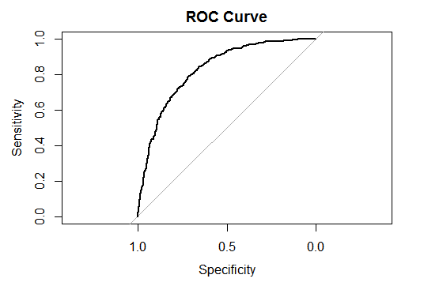
Accuracy
AUC Value → 0.8275
Actual → Predict | 0 | 1
0 | 1154 | 221
1 | 140 | 246
Accuracy → 0.795

